Slide 1
Final Project - Intermediate Python AI Mentorship
oleh: Tariq Fitria Aziz
Data: Air BnB

Slide 2
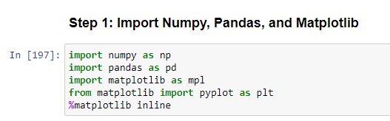
Step 1: Import Packages

Slide 3
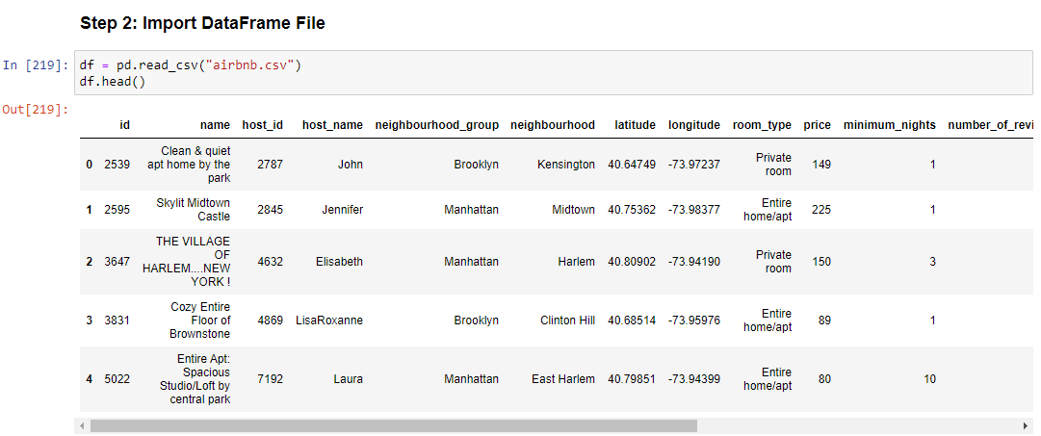
Step 2: Import File as DataFrame

Slide 4
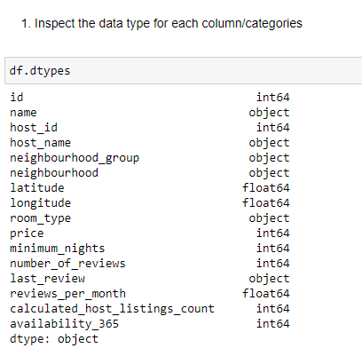
Step 3.1: Inspect Data Types

Slide 5
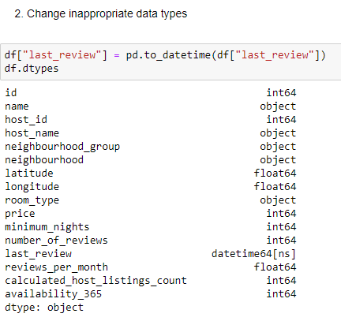
Step 3.2: Change Inappropriate Data Type

Slide 6
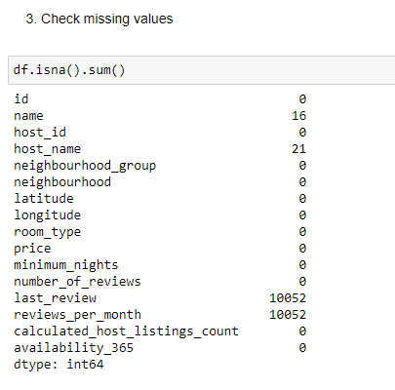
Step 3.3: Check Missing Values

Slide 7
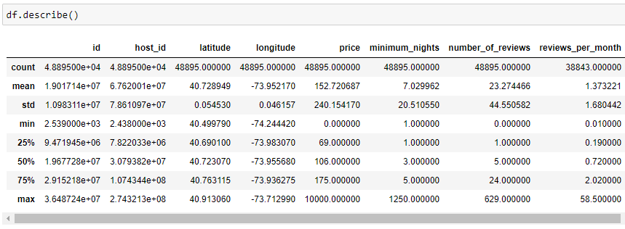
Step 4: Show Statistical Properties

Slide 8
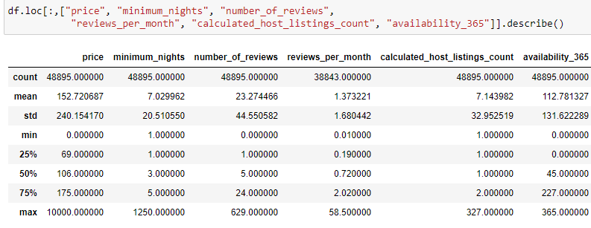

Slide 9
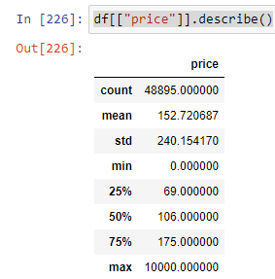

Slide 10
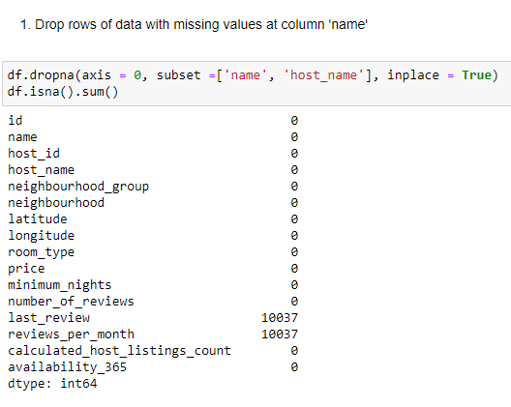
Step 5: Get Rid of Missing Data

Slide 11
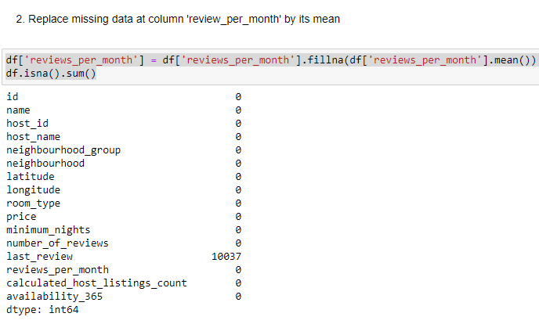

Slide 12
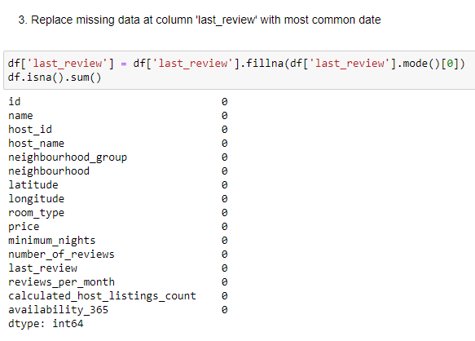


Slide 13
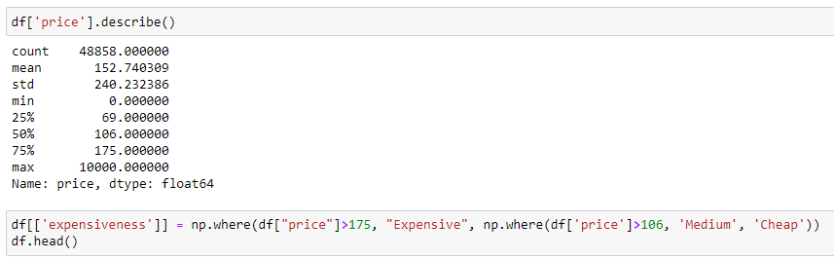
Step 6: Make a New Category based on price

Slide 14
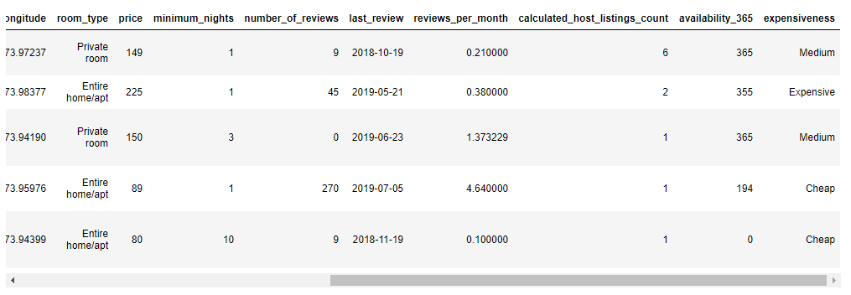

Slide 15
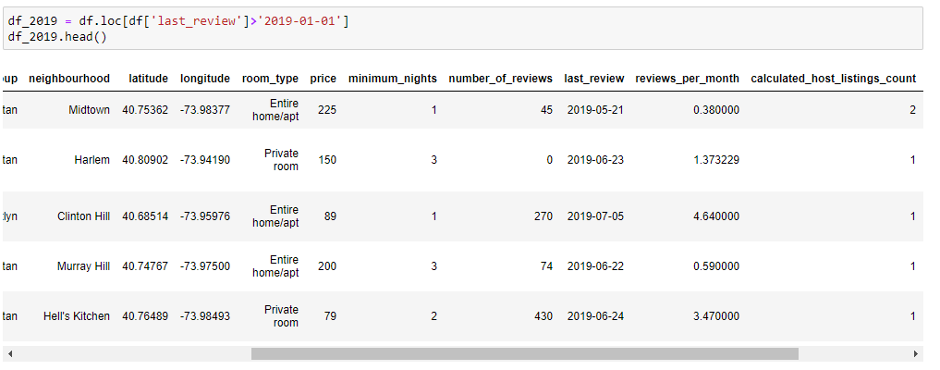

Step 7: Filter All Data with Reviews above 2019

Slide 16
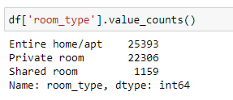
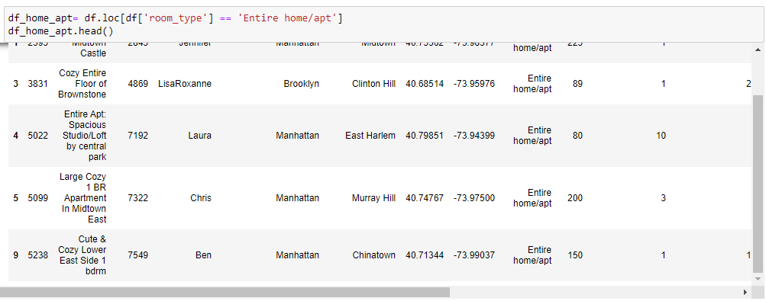
Step 8: Visualize Price Comparison between room

Slide 17
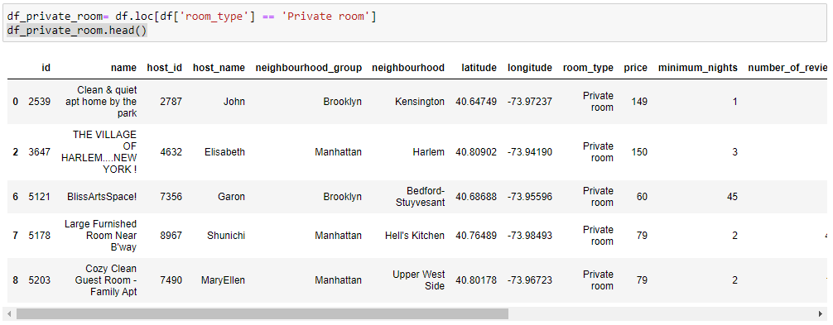

Slide 18
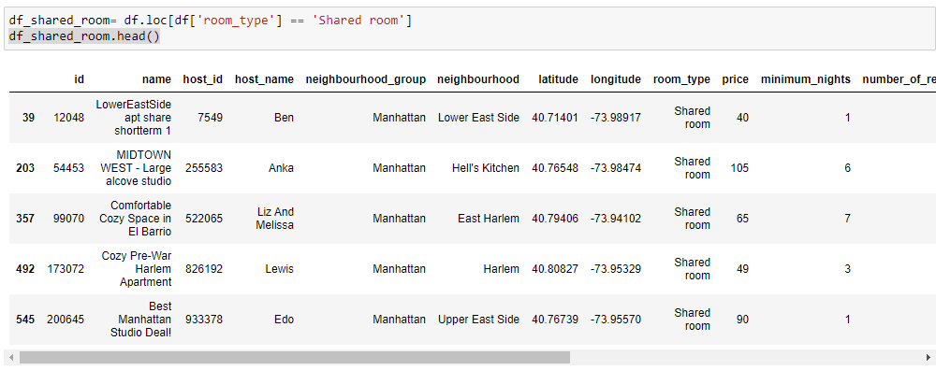

Slide 19
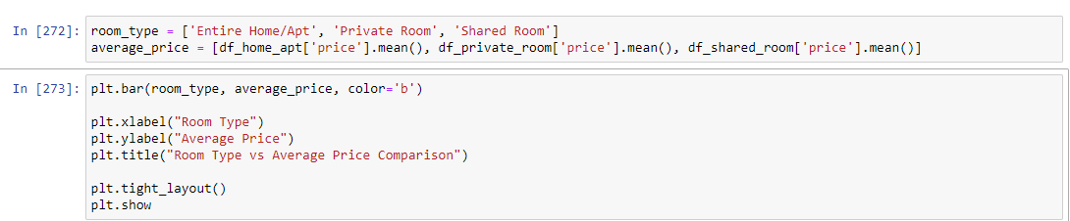

Slide 20
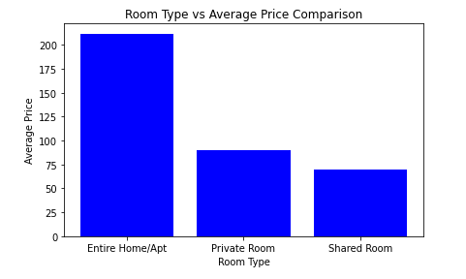
Price Comparison between room types

